Slide 1
Case Study: Amazon US product fit analysis
By Sneha Chogale
June 24, 2023

Slide 2
Overview of Case Study
Determine a top-selling item in the "Home and Kitchen" category that could be introduced to the US market
Search for product listings with a lot of sales and good customer reviews.
Examine the market in the US for similar or equivalent products.
List the top 10 items in the US's Home and Kitchen Category on Amazon.com along with their prices, variations
Task
Process
Research
Findings
Analysis
Execution

Slide 3
Data Details
Sr. No | India |  |  | US
 | Product Name | Brand Name | Selling Price (In INR) | Product Name | Brand Name | Selling Price(In USD)
1 | Oxo-Biodegradable Garbage Bags | Amzon | 339 | Queen Size Sheet Set | CGK Unlimited | 30
2 | Mini Handy and Compact Chopper | Pigeon | 199 | Indoor Plug-In Fly Trap | Safer | 18
3 | Digital Weighing Scale | BeatXP | 249 | Bedsure Satin Pillowcase for Hair and Skin Queen | Bedsure | 6
4 | Hanging, Waterproof Screws Wall Hook | Jialto | 218 | Indoor Decorative Pillows | Utopia Bedding | 16
5 | Electric Kettle | Pigeon | 500 | Queen Bed Sheets Set | Utopia Bedding | 22
6 | Tray/Kitchen Organizer | Spenfrone | 99 | Vacuum Storage Bags | Cozy Essential | 20
7 | Lunch Box | Oliveware | 949 | Liquid Ant Killer | Terro | 14
8 | Room Freshener | Godrej | 126 | Water Bottle Travel Mug | Simple modern | 30
9 | Sleeping Pillow | Wakefit | 758 | Bed Sheet Set | Amzon | 23
10 | Drying Clothes Steel | LiMETRO STEEL | 1799 | Toilet Paper | Charmin | 55
Structured Data*
*Open Excel for detail data
Source: Amazon IN/US

Slide 4
Product Identification
Garbage Bags
Mini Chopper
Digital Weighing Scale
Adjustable
Sleeping Pillow
Quality of material
Easy to use & clean
No electricity required
Fluffy and medium firm
Machine wash
3 Months manufacturer warranty
Biodegradable Garbage disposal
Detachable tie-tape
Cheapest price
2 year warranty
A wide LCD screen display
Light weight
Black bag which is not preferable in US market as they use white, green odor control bags
Already enhanced products available in market
Already enhanced products available in market
Heavily price
Advantage
Disadvantage

Slide 5
US Market for Adjustable Pillows
$ 70
Average price of 2 sleeping pillows
$ 1.3 billion
USA Bed Pillow forecasting Market Valuation
78.5%
Market share for residential segment is likely in 2023
Online retailers' category will progress rate through 2033
7.8%
CAGR
Reference: Sales channel

Slide 6
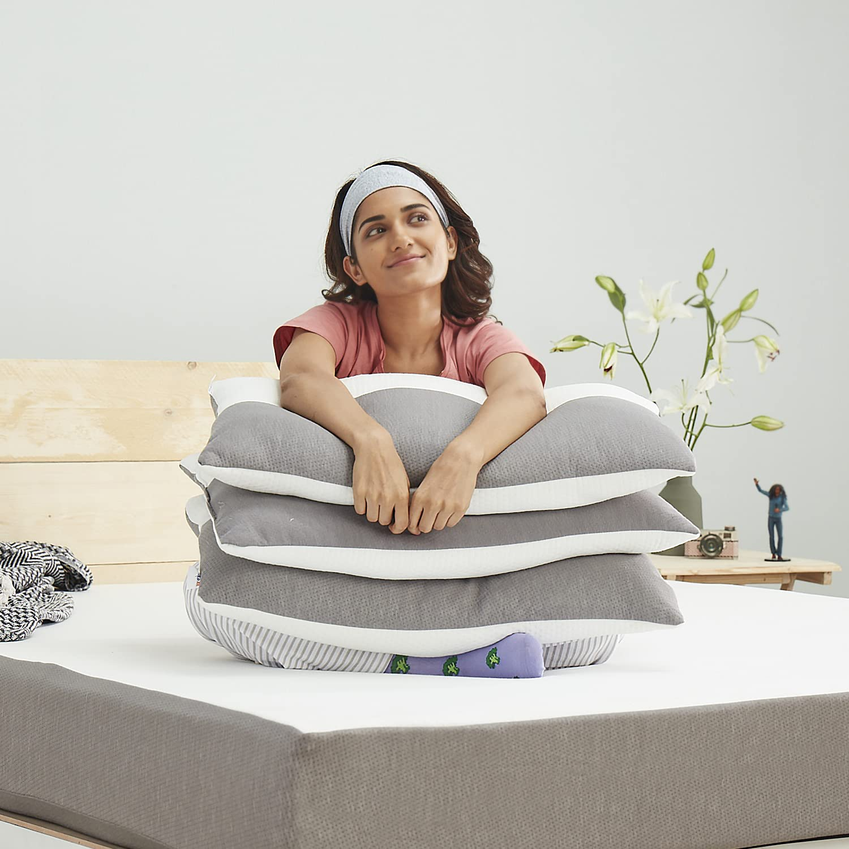
Positioning of the Product
Price
$20-25
USP’s
Use by everyone- No customisation required
From Kids to Adults to Senior
Use while sleeping or as your back support
Carry everywhere
Hotels – No more complaints from customer on pillow heights
Target Audience
Hotel & catering
Family
Travelllers

Slide 7
THANK YOU

